Slide 1
Object-Oriented Programming: Principles and the History of Python
University of Bristol | Week 1
Presented by: Mustafa, Matvei, Alp, Thanat

Slide 2
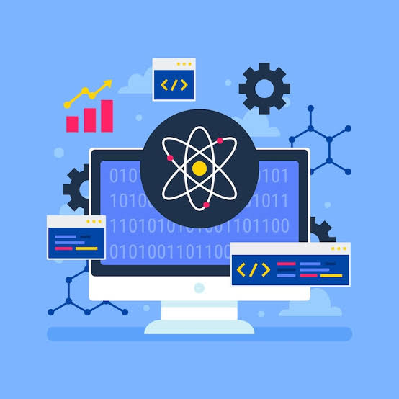
What is computer programming?
Computer programming is process when user make instructions for a computer.
Goal: Solve problems and make process faster

Slide 3

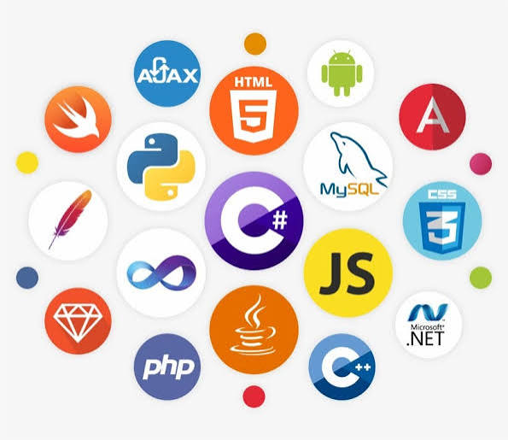
Programming languages
There are two main groups:
Low level: Machine code
High level: Python, C++, Java

Slide 4
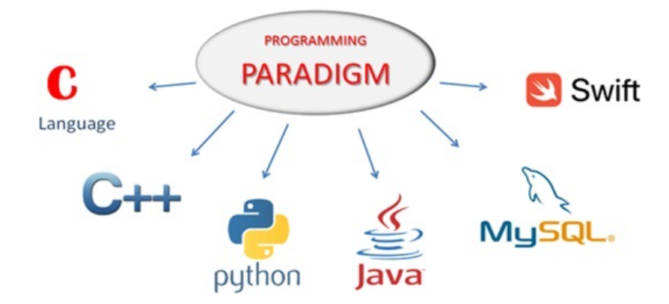
Programming Paradigms
Programming paradigm is one of the ways of writing programs.
Procedural - step by step instructions
OOP - use objects and classes
Functional - use functions for solving problems

Slide 5
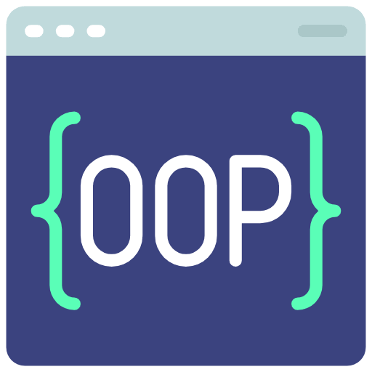
What is OOP?
Object-Oriented Programming (OOP) is another way to write programs, which use objects and classes
Class - blueprint
Object - an example of class
Attributes - information about object
Methods - actions an objects can do

Slide 6
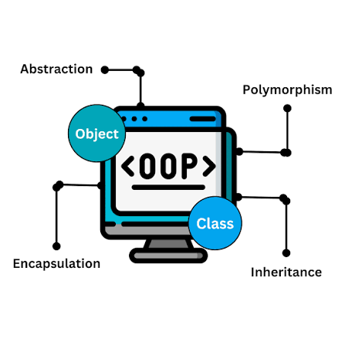
The four principles of OOP
Encapsulation — keeping data safe
• Abstraction — hiding unnecessary details
• Inheritance — reusing code
• Polymorphism — one method, different behaviours

Slide 7
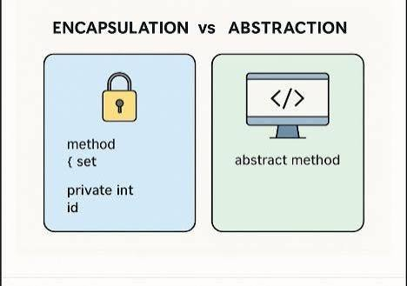
Encapsulation & Abstraction
Encapsulation
• Keep data inside the object
• Protect the data from outside
Abstraction
• Hide complicated stuff
• Show only important things

Slide 8
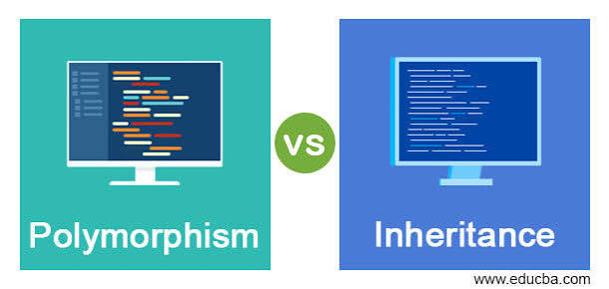
Inheritance & Polymorphism
Inheritance
• One class can use things from another
• Saves time and code
Polymorphism
• Same method, different result
• Depends on the object

Slide 9
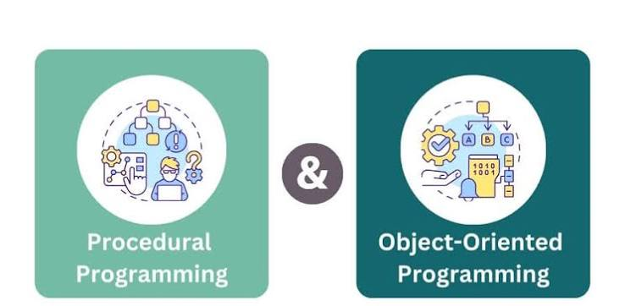
Procedural vs OOP
Procedural
• Code goes step by step
• Focus on functions
• Good for smaller programs
OOP
• Uses classes and objects
• Code can be reused
• Easier to organise bigger programs

Slide 10
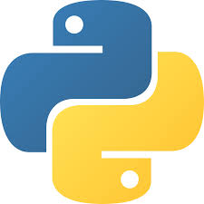
History of python
989
Guido started making Python
1991
Python was released
2000
Python 2 came out
2008
Python 3 came out
2020
Python 2 stopped being supported
Today Python is used for AI, websites and data

Slide 11
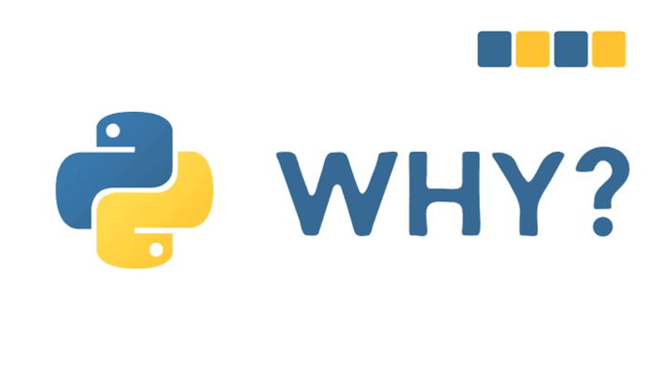
Why Python?
Python is simple to learn
The code is easy to read
It supports OOP
It has many useful libraries
It is used in AI and websites and data science

Slide 12
Conclusion
Programming helps us solve problems
OOP uses classes and objects
The four main principles are Encapsulation, Abstraction, Inheritance and Polymorphism
Python is simple, flexible and widely used
Thank you!

